Slide 1

Smart Things of Internet
Take your home with you

Slide 2



Smart Things of Internet
Group Members:
S Guru Prasanna 1NT12EC135
S Pradeep 1NT12EC136
Sandesh H S 1NT12EC144
Sriharsha S Jadhav 1NT12EC168
Project Guide: Ms. Rekha Phadke

Slide 3
Outline
Why IoT ?
What is Internet of Things, applications
Why SToI
How did this start
Hardware
Software
How do they work?
Risks, future and conclusion

Slide 4


Why IoT ?
We want to collect more data
We want to control stuff
We want to automate
We want to make things to be accessible faster

Slide 5
What is the Internet of Things
Sensors
Local Processing
Network
Internet
Cloud Access
Local storage

Slide 6

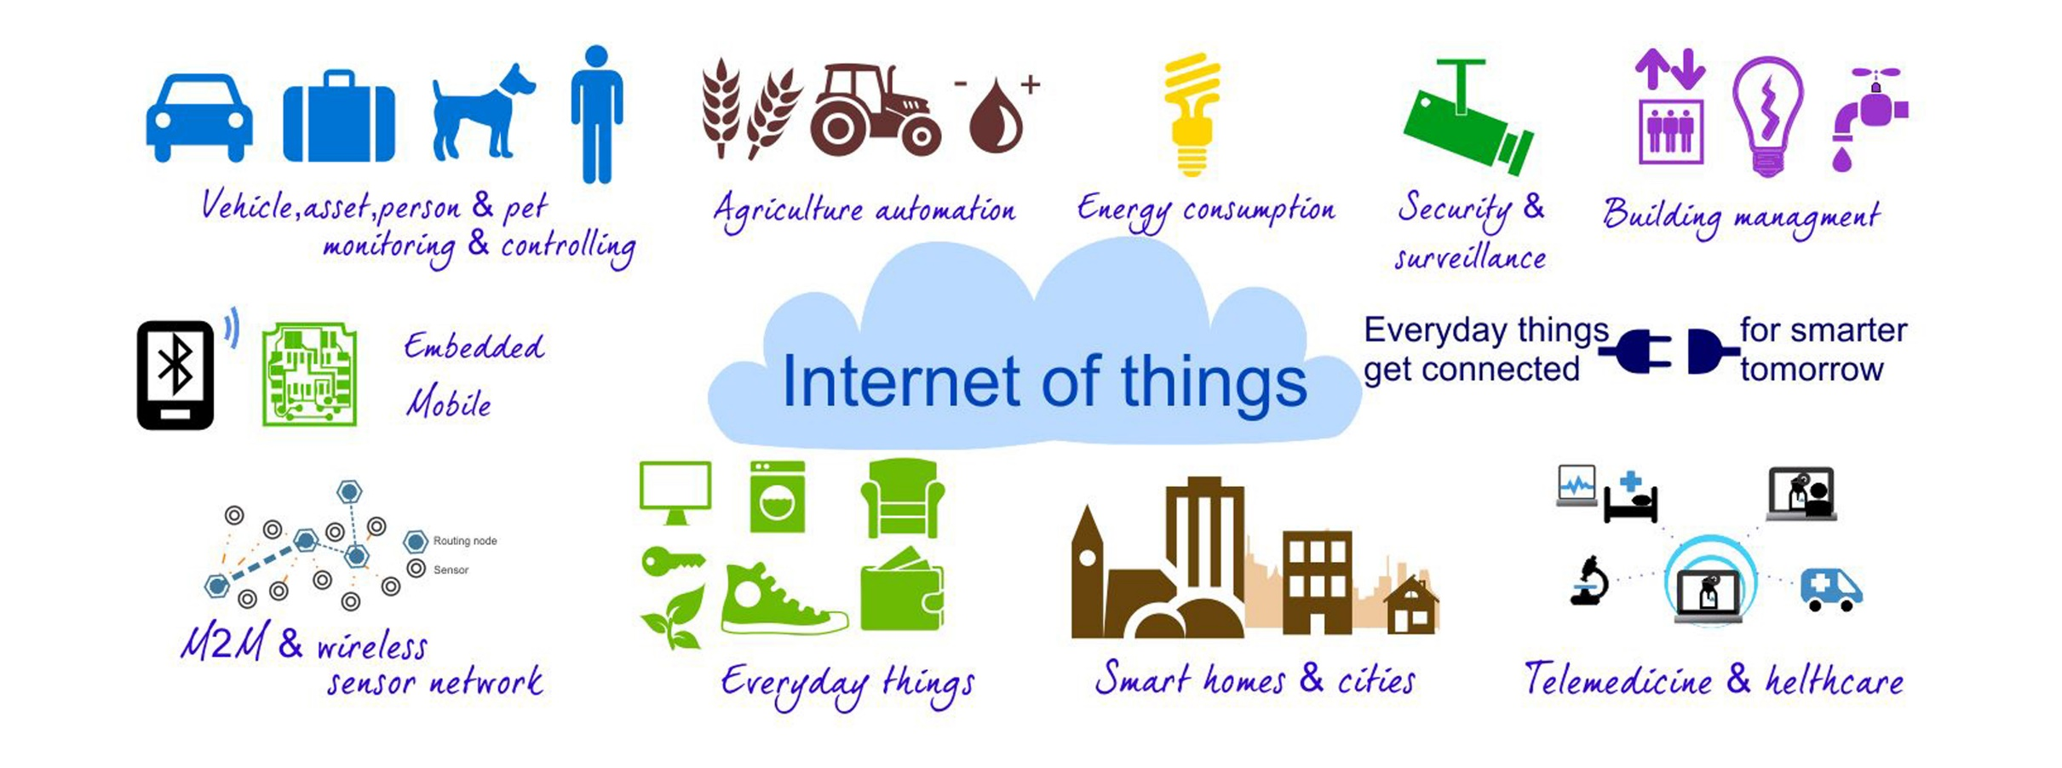
Applications

Slide 7
Why SToI
Objectives
Safety – Gas and flame sensing
Security – Doorbell notification and door ajar monitoring
Comfort / luxury –
Two way switching of lights
Temperature based automation of Socket
Smart Socket
Energy management - Ambient light switching

Slide 8

HARDWARE AND SOFTWARE

Slide 9
Hardware
Raspberry Pi-2
Voltage Regulator
Arduino UNO, Pro-Mini
Voltage Converter (Hi-Link HLK-PM01)
nRF Module (nRF24L01)
Sensors
Relay

Slide 10
Sensors
Reed
Light Dependent Resistor
Gas
Flame
DHT-11
Capacitive Touch

Slide 11
Software
Domoticz
Arduino IDE
Appy pie

Slide 12


SToI Android application
The app work on android 4.0 + platform
Min hardware required :1ghz quad core processor, 1 GB of RAM, HD display and internet connection (Wi-Fi or 3G/4G),
Access point for remote control
Can be used to turn on and off any of the switches and sockets
Indicates the current condition of the things

Slide 13
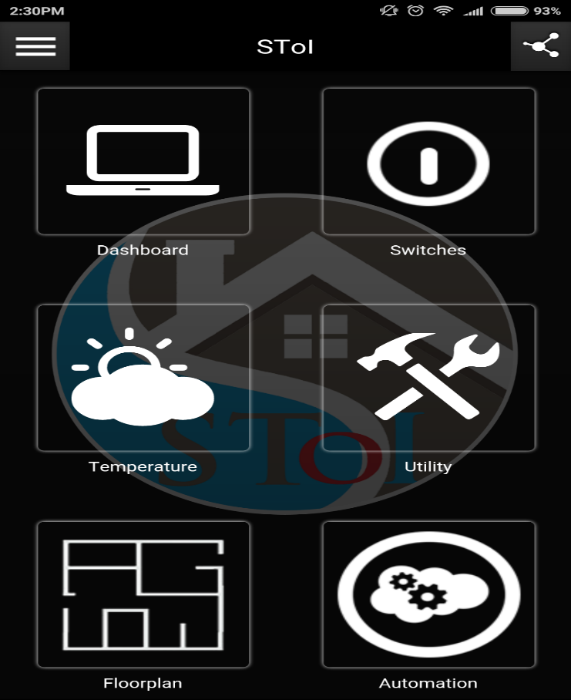
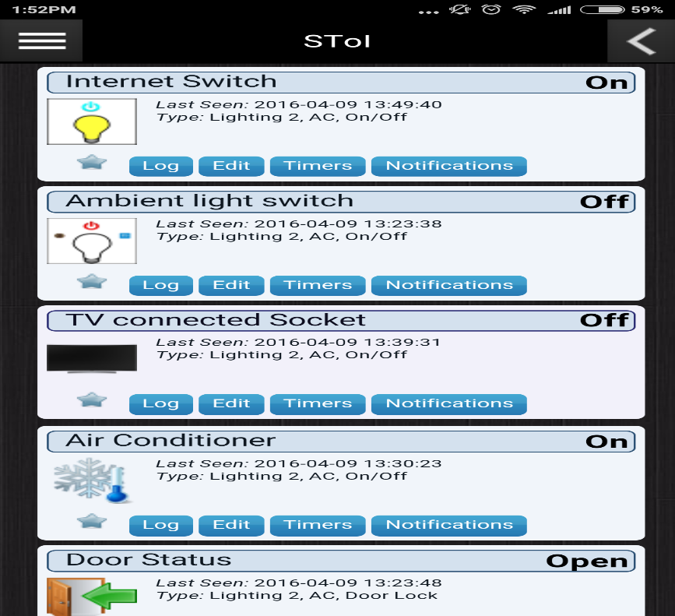
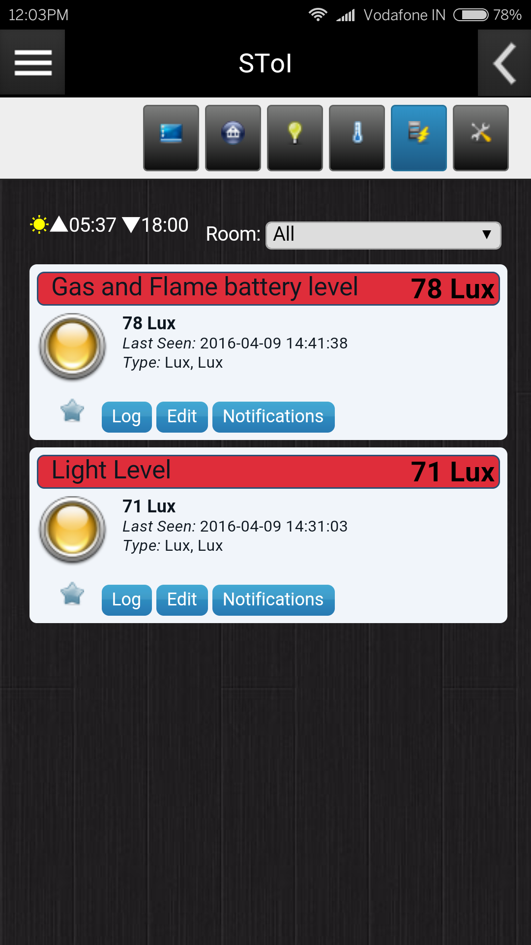
SToI Android application
Switches
utility
HOME PAGE

Slide 14
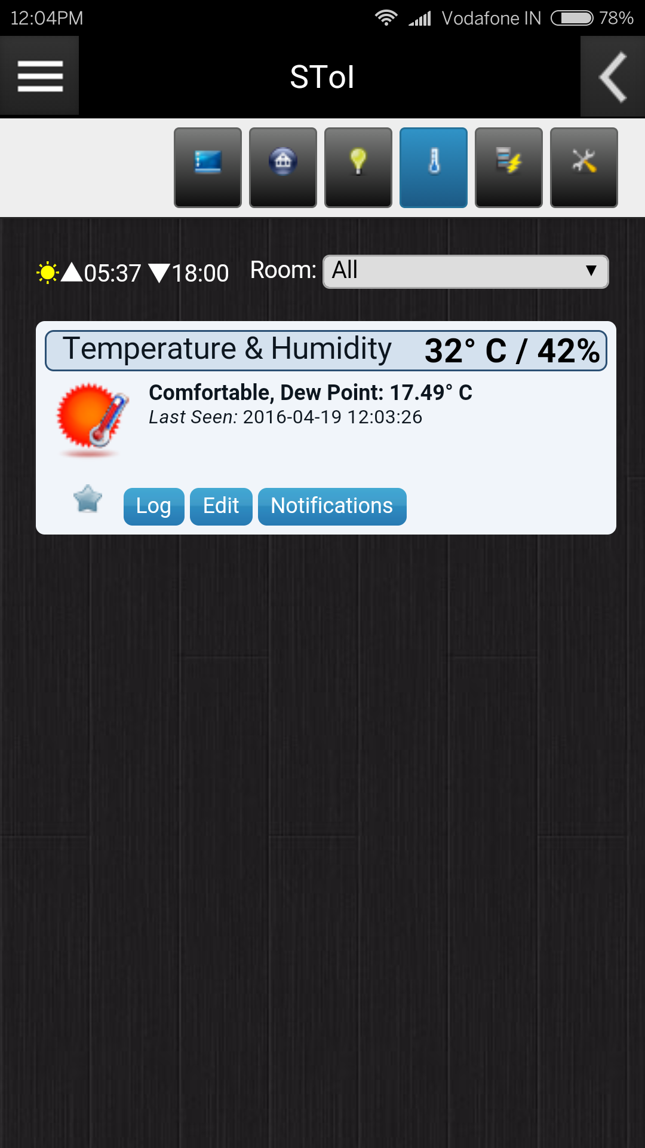
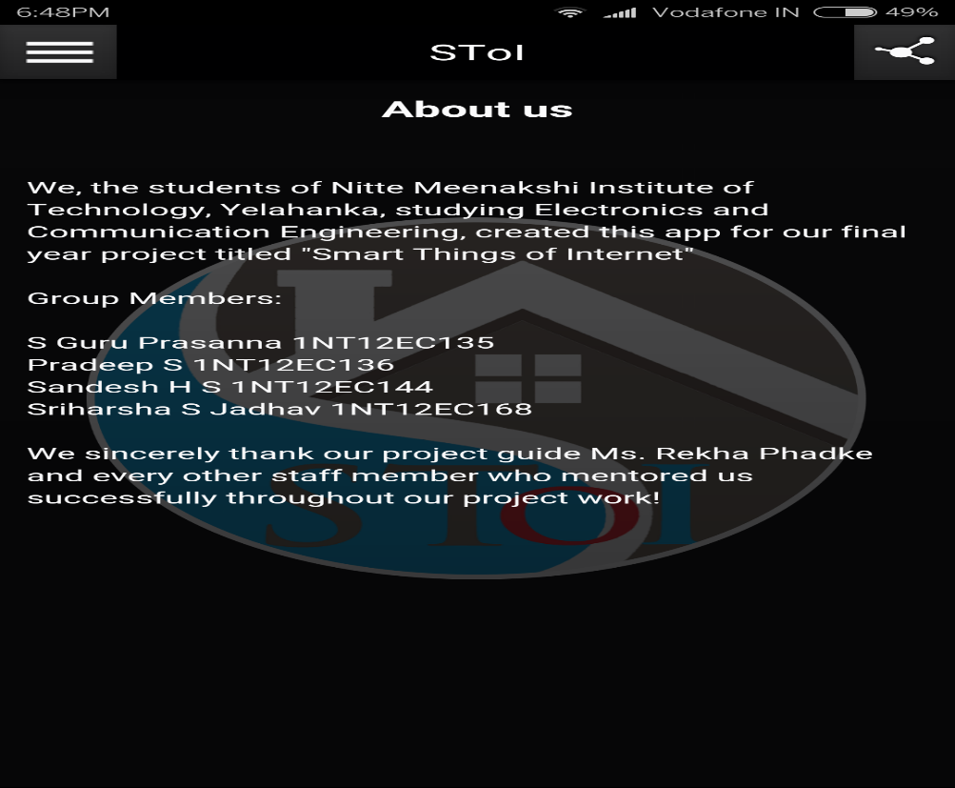
SToI Android application
Temperature
About us

Slide 15
Things
Doorbell Notification and Door Ajar monitoring
Gas Leak and Flame Detection module
Temperature based automated Socket
Smart Socket
Energy saver switch
IoT Switch

Slide 16
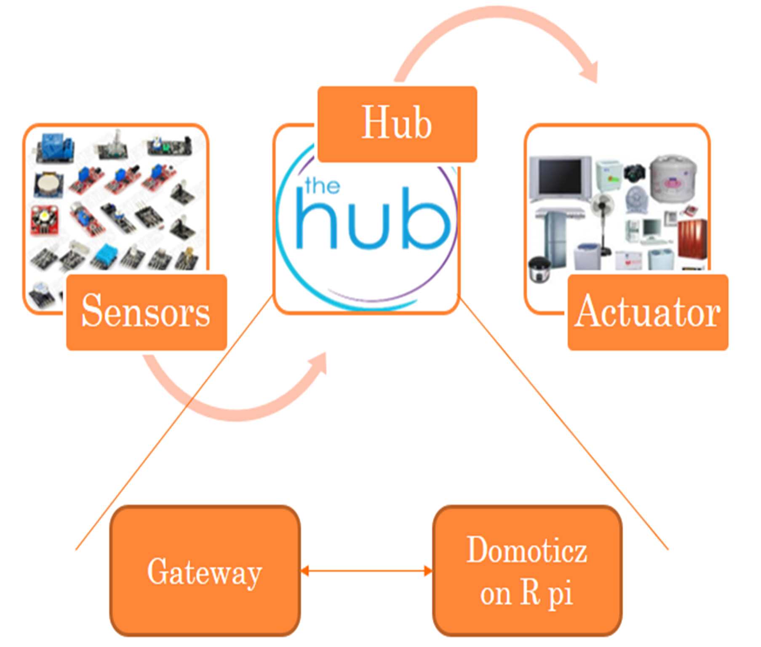
Block Diagram

Slide 17
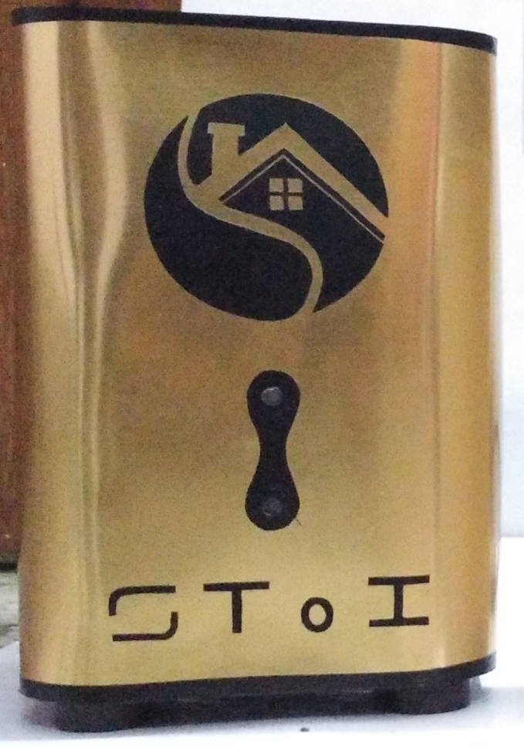
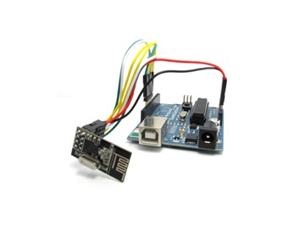
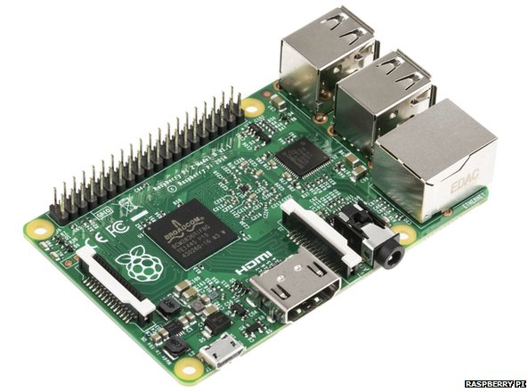
Hub
Raspberry pi
Domoticz OS
Connect to the internet-gateway
Arduino UNO + nRF
Serial gateway
Parent node

Slide 18
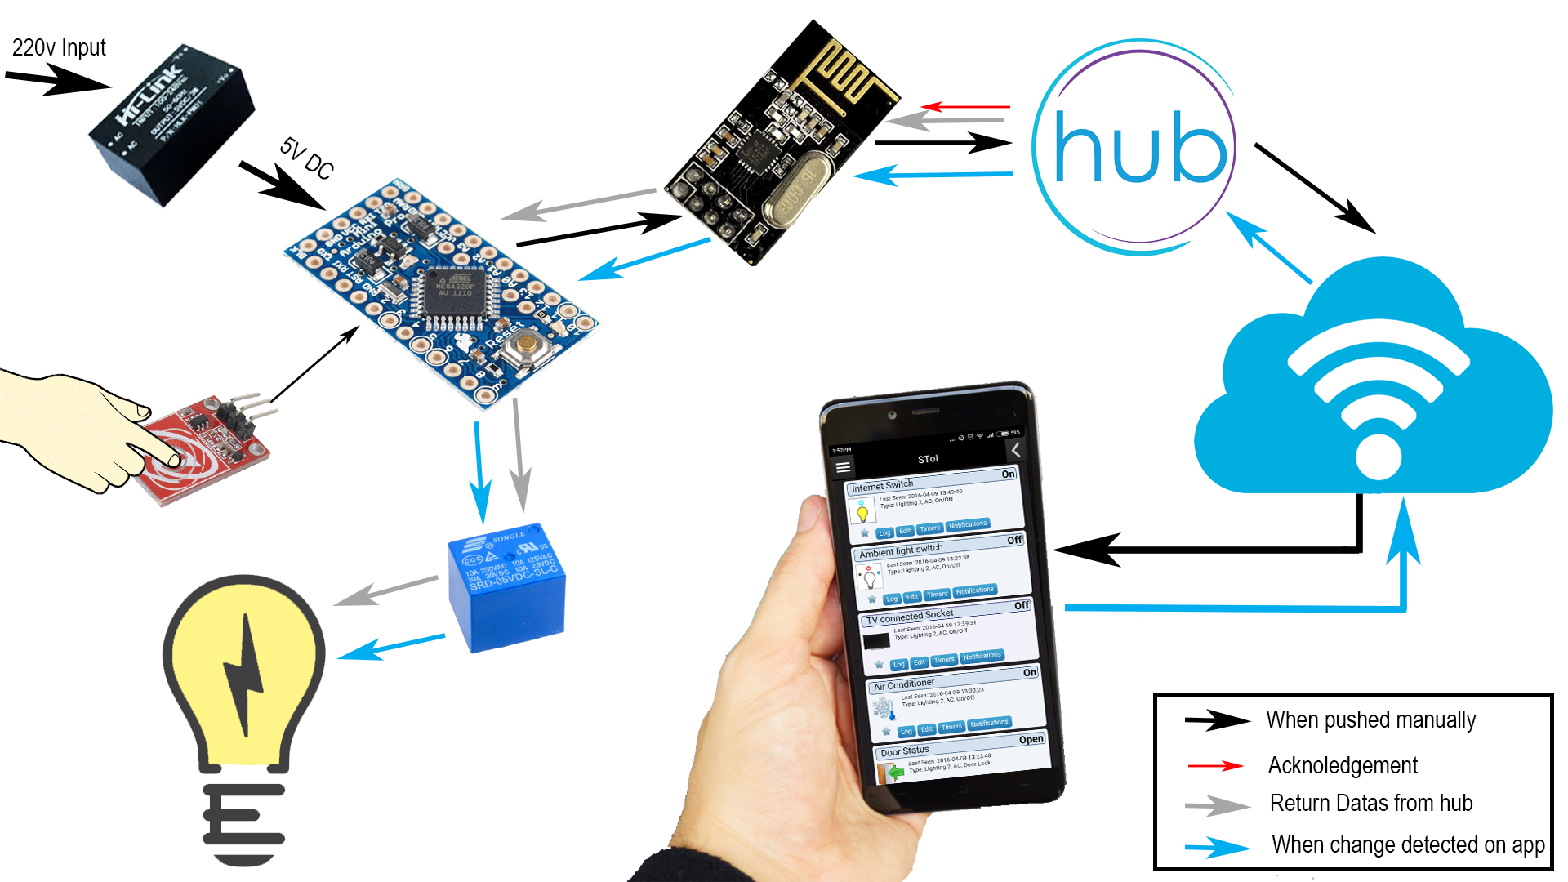
HOW THINGS WORK?

Slide 19
Devices
IoT switch
Energy Saver Switch
Smart socket
Temperature based Automated socket
Gas & Flame detector
Door bell monitor

Slide 20
Gas Leak and Flame Detection module - notifications

Slide 21
Doorbell Notification and Door Ajar monitoring switch

Slide 22
Conclusion
This project “Smart Things of Internet” tries to address these problems by taking a new direction by bringing in the concept of modularity and using an open source system/approach.
SToI is designed in such a way that it replaces an existing switch and provide a full-fledged IoT experience to the user.
The SToI devices can be operated manually without the need of the network.
The remote access feature of this system is the real deal maker for this project,it enables the user to take complete control of his house from anywhere.
The android application lets users securely control their home from the palm of their hand.

Slide 23

Risk
Personal/Business risk:
Operational risk:
Technical risk:

Slide 24

Challenges and open Issues
Standards:
Identification:
Privacy:
Security:
Integration:
Coordination:
Data Storage:
Network Self-Organization:

Slide 25

Future Scope
In system architecture design domain:
In communication protocol domain:
In security domain:
Using smart sensors

